Slide 1
‘Exposure’
By Wilfred Owen

Slide 2
What is ‘exposure’?
‘Exposure’ by Wilfred Owen

Slide 3
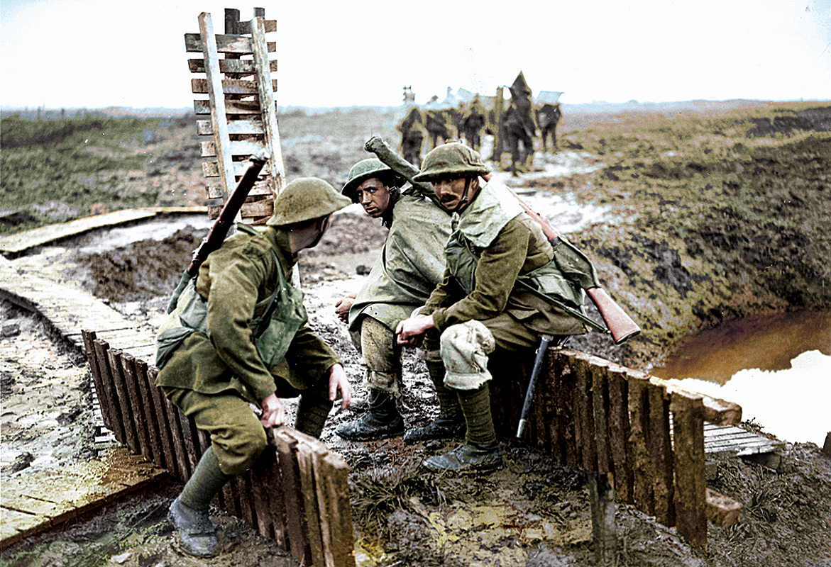

Slide 4
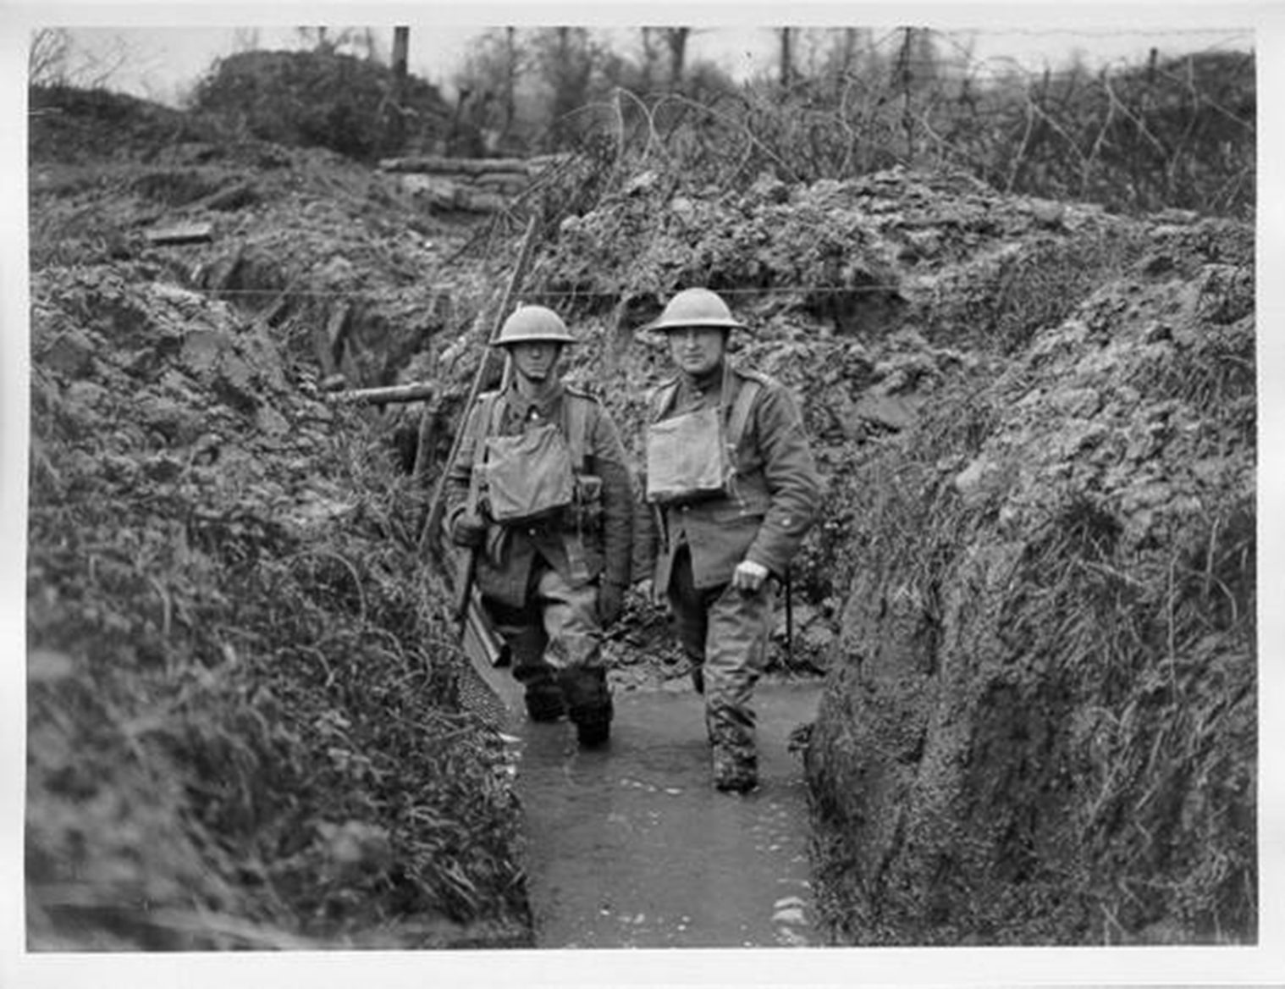

Slide 5
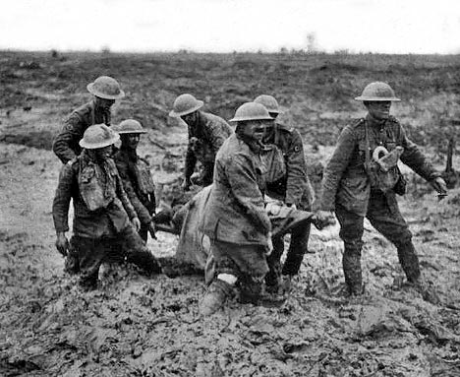

Slide 6
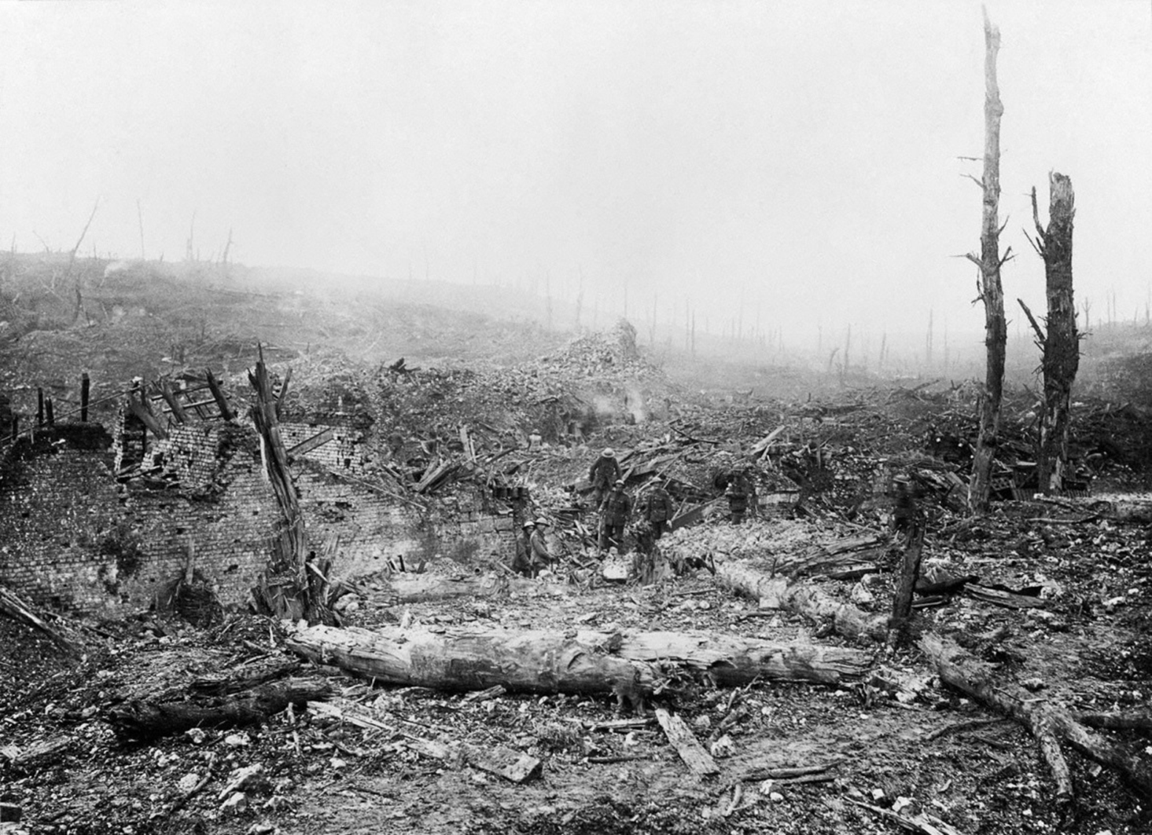

Slide 7
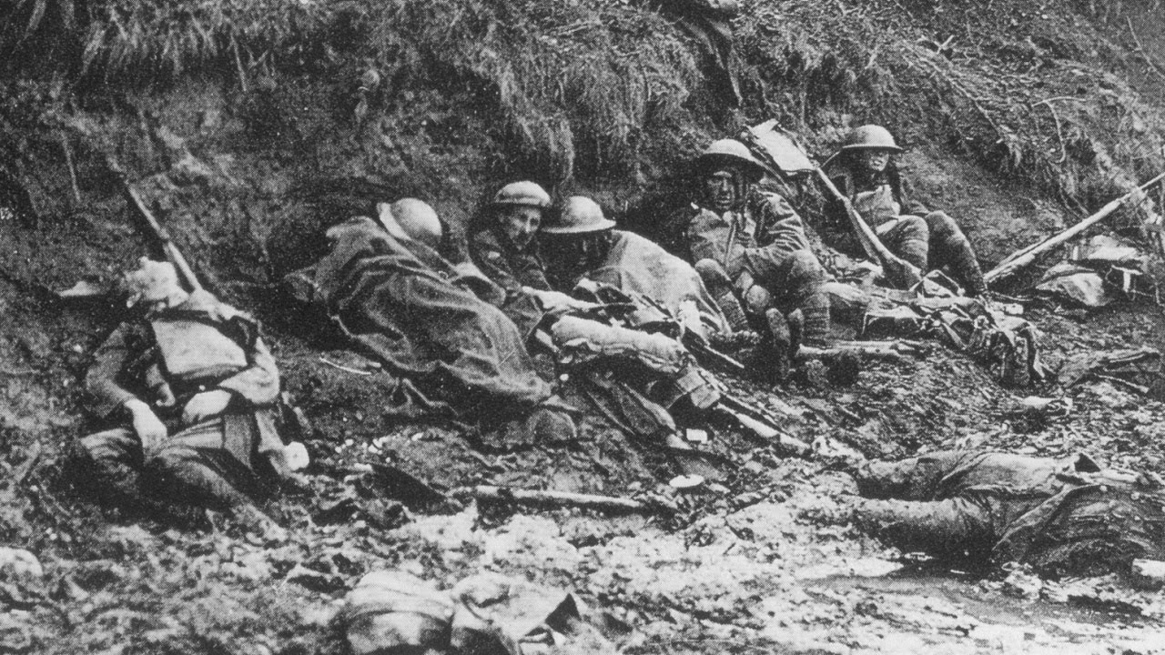

Slide 8
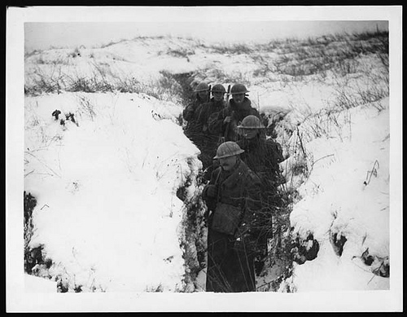

Slide 9
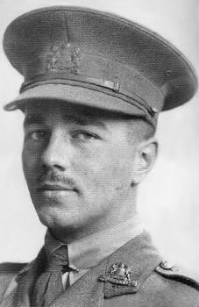
Wilfred Edward Salter Owen, MC (18 March 1893 – 4 November 1918) was an English poet and soldier, one of the leading poets of the First World War. His shocking, realistic war poetry on the horrors of trenches and gas warfare stood in stark contrast both to the public perception of war at the time and to the confidently patriotic verse written by earlier war poets.
On 4th November, 1918, he was shot by a German machine-gunner during an unsuccessful attempt to cross the Sambre Canal, near the French village of Ors.

Slide 10
What we learn from this poem
In war, the real enemy is nature or the elements (‘pale flakes with fingering stealth come feeling for our faces’).
War can kill a man in a spiritual, if not a physical way (‘Slowly our ghosts drag home’)
War can lead to a loss of faith in God/God is responsible for the suffering caused by nature (‘Tonight, His frost will fasten on this mud and us’).

Slide 11
Pronouns makes it personal – esp. as he’s an officer -> he’s with his men
Personification: suggests that the wind is vindictive and without compassion, whilst 'knife' is a violent verb, implying that it is an attacker inflicting pain. From the outset, the 'personality' of the weather is established as an enemy.
Our brains ache, in the merciless iced east winds that knife us... Wearied we keep awake because the night is silent... Low drooping flares confuse our memory of the salient... Worried by silence, sentries whisper, curious, nervous, But nothing happens.
The sibilant hissing ‘s’s combined with hard consonants ‘d’ and ‘t’ create a cutting, bitter edge to the elements which ‘knife’ the men

Slide 12
More Personification: suggests that the wind is mad with anger
Simile: Horrific image: wind is causing barbed wire to twitch like a dying man
Watching, we hear the mad gusts tugging on the wire. Like twitching agonies of men among its brambles. Northward incessantly, the flickering gunnery rumbles, Far off, like a dull rumour of some other war. What are we doing here?
This question is directed at the reader; it’s answered in stanza 5…

Slide 13
assonance to emphasise the mood of the narrative: the long ‘oh’ o draws out the painful process of awakening
More Personification: ‘Dawn’ only brings another day of ‘poignant misery’
The poignant misery of dawn begins to grow... We only know war lasts, rain soaks, and clouds sag stormy. Dawn massing in the east her melancholy army Attacks once more in ranks on shivering ranks of gray, But nothing happens.
combines with hard consonants to create a bleak and dismal atmosphere
personified as a weary female war commander. The ‘army’ of clouds is like German army uniforms: ‘grey’, ‘stormy’ and lined up in ‘rank upon shivering rank’, ready to attack.

Slide 14
More Personification: even the snow-flakes appear to make conscious decisions about where they will settle / whom they will attack
Deadly sibilance here.
Creates fear.
Sudden successive flights of bullets streak the silence. Less deadly than the air that shudders black with snow, With sidelong flowing flakes that flock, pause and renew, We watch them wandering up and down the wind's nonchalance, But nothing happens.
More Personification: wind is also human in its apathy or concern, its ‘nonchalance’ in the face of mass suffering

Slide 15
Beautiful image of where they want to be hides the reality of the previous 2 lines
More Personification: The flakes have ‘fingers’ which feel for the faces of the men
Pale flakes with lingering stealth come feeling for our faces - We cringe in holes, back on forgotten dreams, and stare, snow-dazed, Deep into grassier ditches. So we drowse, sun-dozed, Littered with blossoms trickling where the blackbird fusses. Is it that we are dying?
Answer to stanza 2’s question…
Collectively, the personified wintry elements are as much an enemy on the attack as are the Germans.

Slide 16
Assonance conveys effort required by cold soldiers to engage with a world beyond their current environment, such slow reactions being typical of the onset of hypothermia. The effort wasn’t worth it – everything was ‘closed.’
Slowly our ghosts drag home: glimpsing the sunk fires glozed With crusted dark-red jewels; crickets jingle there; For hours the innocent mice rejoice: the house is theirs; Shutters and doors all closed: on us the doors are closed - We turn back to our dying.
Sad image of the soldiers in France being totally disregarded and forgotten about by those back in England: their homes are empty.

Slide 17
The spring that God will make follow winter frightens them as they feel they won’t be alive to see it
Since we believe not otherwise can kind fires burn; Now ever suns smile true on child, or field, or fruit. For God's invincible spring our love is made afraid; Therefore, not loath, we lie out here; therefore were born, For love of God seems dying.
God’s love for them is in doubt and their faith in him has dwindled due to the war

Slide 18
God’s frost will freeze EVERYTHING. Burial parties will see those who died of exposure while nothing in particular was happening in the war. They were felled by wind, snow, mud, AND the seeming indifference of God rather than by wounds caused by bullets and bayonets. ☹
To-night, His frost will fasten on this mud and us, Shrivelling many hands and puckering foreheads crisp. The burying-party, picks and shovels in their shaking grasp, Pause over half-known faces. All their eyes are ice, But nothing happens.
Nothing is being achieved by the soldiers’ sacrifice
Short phrase / horrific image: literally, the eyes are frozen by cold.
Their eyes can no-longer see the horror of war.

Slide 19
The Dominant Elements
Owen’s choice of words in Exposure powerfully, but simply, describes the extremes to which he and his men were exposed for two days. The poem is dominated by words from the semantic field of the weather, most of which are qualified by terms with negative associations:
‘iced east winds’ l.1
‘mad gusts’ l.6
‘rain soaks’ l.12
‘clouds sag stormy’ l.12
‘Dawn massing in the east’ l.13
‘ranks of grey’ (cloud) l.14
‘air .. black with snow’ l.17
‘flowing flakes’ (snow) l.18
‘the wind’s nonchalance’ l.19
‘Pale flakes ‘ (snow) l.21
‘snow-dazed’ l.22
‘frost’ l.36
‘ice’ l.39
A group words connected by a shared meaning, in this case: the weather

Slide 20
Structure and versification in ‘Exposure’
Each of Owen’s eight stanzas ends with a short half line. In the first, third, fourth and final verses Owen creates the burden: ‘But nothing happens’. Each of the short, last lines in the remaining stanzas has a story of its own to tell. When written or read out these lines read:
‘What are we doing here?’
‘Is it that we are dying?’
‘We turn back to our dying.’
‘For love of God is dying.’
The first question is answered by the second, which prompts the action of the third. The penultimate verse ends emotionally and perhaps ambiguously. Here on the field of battle the men make Christ-like sacrifices for those they love. Yet Owen suggests the love of God for them, and their faith in God, seems to have died…

Slide 21
Structure and impact on reader in ‘Exposure’
The five line stanzas are constant throughout, using half rhyme to form a ABBA - C rhyme scheme. What is interesting in this poem is the fifth line - it defies our expectations when reading it. A reader would either expect the stanza to finish at the end of the fourth line, or to continue after the end of the shortened fifth line. By extending beyond the fourth, Owen could be showing that war is dragged out longer than is expected. Indeed, the ellipses (...) indicate long missing periods of nothingness, where the events are too empty to be written into the poem. This enhances the impression of time being drawn out. However, the fifth line being shortened creates an alternative effect of the stanza being cut off too early. Is this representative of life being cut short?

Slide 22
Rhyme
Owen’s use of pararhyme (a partial or imperfect rhyme which does not rhyme fully but uses similar rather than identical vowels) is clearly developed in ‘Exposure’. The sounds create disharmony and challenge our expectation, yet Owen uses a regular pattern of ab ba, which creates the sense of stillness. Nothing changes in the rhyming pattern AND nothing happens on the front.

Slide 23
The action is all in the rhymes. Pick 1 and annotate your poem accordingly.
‘knife us’ / ‘nervous’ l.1,4: The attack of the wind may mask the attack of the human enemy, causing fear
‘silent’ / ‘salient’ l.2,3: The sleepless anxiety caused by the utter quiet of the night makes the men forget the important features of the battle field
Wire/war l.2/l.3 Owen pulls together the minutiae of conflict - the barbed ‘wire’ l.6 with the collective noun ‘war’ l.9 which consolidates the whole horror
Brambles/rumbles l.7/l.8 Owen takes his image from nature but succeeds in showing us the barbs on the wire. Again a small detail is set against the distant booming of artillery fire
Dawn is seen and in an almost comic rhyme her ‘clouds sag stormy’ l.12 which constitute her melancholy ‘army’ l.13.
‘Silence’ l.16 half rhymes with good effect with ‘nonchalance’ l.19 and emphasises the carelessness of nature
Snow feels the ‘faces’ l.21 and from this Owen makes the transition to dreams of warmth and an English late Spring as ‘snow dazed’ men become ‘sun dozed’ where the blackbird ‘fusses’ l. 24
The fires of home are ‘glozed’ l.26, a mixture of the words ‘glazed’ and ‘glowed’ but only lead onto doors that ‘close’. These fires ‘burn’ but not for the men who were ‘born’ to die.

Slide 24
Rhythm in ‘Exposure’
Within each stanza, four lengthy lines set the scene and tell what story there is to tell. Often they are hexameters (6 beats per line) but Owen frequently adds extra syllables or whole metrical feet, and does not use a consistent metre, perhaps representing how snow-dazed minds struggle to stay orderly and focused.
One short line punctuates the narrative with the reality: ‘but nothing happens’ l.5. This serves as a contrast to the huge events which are to do with ‘dying’: the death of men, of hope, of belief and of the love of God.

