Slide 1
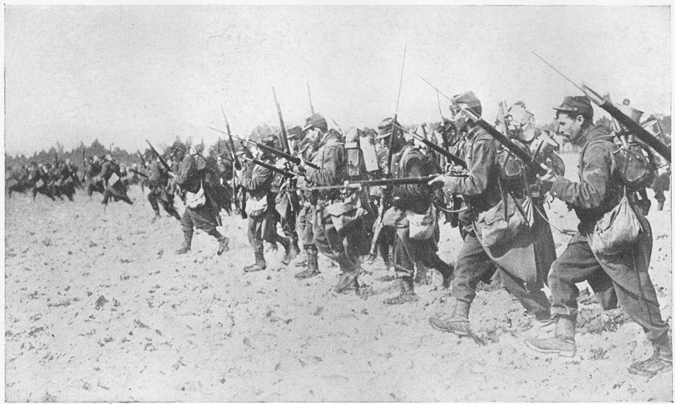
Ted Hughes ‘Bayonet Charge’
Suddenly he awoke and was running – raw
In raw-seamed hot khaki, his sweat heavy,
Stumbling across a field of clods towards a green hedge
That dazzled with rifle fire, hearing
Bullets smacking the belly out of the air –
He lugged a rifle numb as a smashed arm;
The patriotic tear that had brimmed in his eye
Sweating like molten iron from the centre of his chest, –
In bewilderment then he almost stopped –
In what cold clockwork of the stars and the nations
Was he the hand pointing that second? He was running
Like a man who has jumped up in the dark and runs
Listening between his footfalls for the reason
Of his still running, and his foot hung like
Statuary in mid-stride. Then the shot-slashed furrows
Threw up a yellow hare that rolled like a flame
And crawled in a threshing circle, its mouth wide
Open silent, its eyes standing out.
He plunged past with his bayonet toward the green hedge,
King, honour, human dignity, etcetera
Dropped like luxuries in a yelling alarm
To get out of that blue crackling air
His terror’s touchy dynamite.

Slide 2
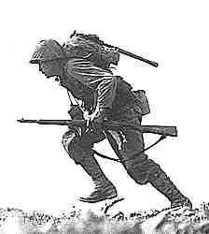
The pronoun ‘he’ suggests this could be any young soldier.
The poem begins in medias res, highlighting the unpredictable, chaotic and dangerous nature of war.
Suddenly he awoke and was running – raw
In raw-seamed hot khaki, his sweat heavy,
The repetition of the word ‘raw’ could reinforce the soldier’s pain, or it could emphasise the soldier’s inexperience and lack of preparation.

Slide 3
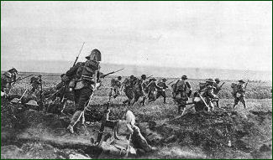
The verb choices create a sense of action and confusion. The soldier’s confusion is emphasised by the use of enjambment.
Stumbling across a field of clods towards a green hedge
That dazzled with rifle fire, hearing
Bullets smacking the belly out of the air –
The enemy is unseen and dehumanised, making them more frightening.
This metaphor highlights the violence of war. The bullets are hitting this air, implying that war disrupts nature as well as humans. The use of onomatopoeia emphasises the sound of the bullets being fired.

Slide 4
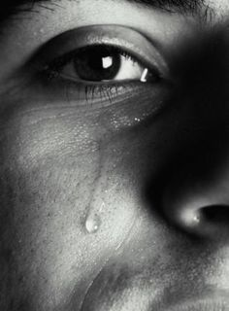
The verb ‘lugged’ implies it is an effort for the soldier to carry his rifle.
This simile suggests that the soldier’s rifle seems useless in battle.
He lugged a rifle numb as a smashed arm;
The patriotic tear that had brimmed in his eye
Sweating like molten iron from the centre of his chest, –
This simile suggests that the soldier’s patriotism has been replaced by pain and fear now he has seen the reality of war.

Slide 5
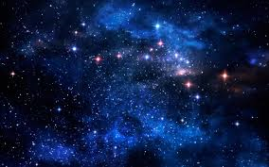
The use of dashes reflects the soldier’s uncertainty about what he’s doing and the confusion on the battlefield.
In bewilderment then he almost stopped –
In what cold clockwork of the stars and the nations
Was he the hand pointing that second?
This rhetorical question emphasises the soldier’s insignificance. He doesn’t feel like he is in control of his destiny. The phrase ‘cold clockwork’ suggests he is part of a machine that is uncaring.

Slide 6
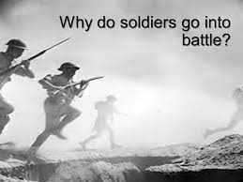
He was running
Like a man who has jumped up in the dark and runs
Listening between his footfalls for the reason
Of his still running, and his foot hung like
Statuary in mid-stride.
This simile suggests that the soldier doesn’t know why he’s running. He feels he is metaphorically ‘in the dark’ about the reality and horror of war. This emphasises the idea that he was unprepared.

Slide 7
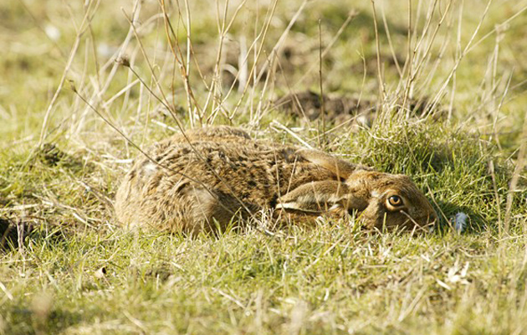
The hare crawls in a ‘circle’ which gives the impression it is trapped.
Then the shot-slashed furrows
Threw up a yellow hare that rolled like a flame
And crawled in a threshing circle, its mouth wide
Open silent, its eyes standing out.
This simile reflects the danger the hare is in, and it reinforces the impact conflict has on nature. The hare’s movement imply it is terrified and helpless – like the soldier.

Slide 8
This simile suggests that when faced with the horrors of battle, the reasons for going to war are insignificant and irrelevant. By calling the reasons ‘luxuries’, Hughes implies soldiers are reduced to a basic level of existence in battle: survival.
This list outlines the reasons people may go to war. However, the addition of ‘etcetera’ at the end undermines these reasons.
He plunged past with his bayonet toward the green hedge,
King, honour, human dignity, etcetera
Dropped like luxuries in a yelling alarm
The ‘green hedge’ is repeated, suggesting the soldier is determined to complete his task.

Slide 9
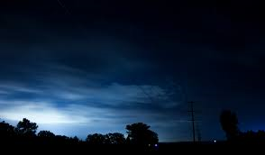
To get out of that blue crackling air
His terror’s touchy dynamite.
The last line of the poem implies the solider is about to lose control of his emotions. His fear seems to have become a weapon; he is driven by his ‘terror’, and this is what is driving him towards the enemy.

Slide 10
Compare how poets present the experience of soldiers in ‘Bayonet Charge’ and one other poem from ‘Power and conflict’.
S | ‘Suddenly he awoke’ The poem begins in medias res to show the chaos of war. The word ‘awoke’ reminds the reader that this is reality.
P | ‘raw’ The word ‘raw’ is repeated to emphasise the soldier’s inexperience. Another interpretation is that the word ‘raw’ reinforces the pain the soldier is in.
L | ‘terror’s touchy dynamite’ The soldier’s fear is driving him forward. Fear has become a weapon as it could make him act at any moment.
I | ‘Sweating like molten iron from the centre of his chest’ This simile suggests that the strength he felt from his patriotism is leaving him and being replaced by pain and fear.
T | ‘King, honour, human dignity etcetera’ This list shows the reasons why people go to war. ‘King’ (or patriotism is first), suggesting it’s the most important. However, these are undermined by the ‘etcetera’.

Slide 11
Which poem would you choose to compare to ‘Bayonet Charge’?
KEY THEMES:
Effects of conflict
Reality of conflict
Fear
Individual’s experience of conflict
Which poem would make a good comparison?
‘Charge of the Light Brigade’
‘Exposure’
‘Remains’

