Slide 1
Imagine you are in your GCSE Literature exam, and have been asked to analyse how Lady Macbeth is presented as a villain.
‘Come, you spirits that then on mortal thoughts, un-sex me here/ And fill me from the crown to the toe, top full of direst cruelty.’
1.Write out the quotation.
2. Annotate it for techniques.
3. Write your paragraph.
What is villainous about her, and does she have any good qualities? Is she a classic or stereotypical villain? Point
How does Shakespeare show she is villainous in the play? Evidence/ Terminology
Why does he do this? What does the audience realise, what does he want us to realise about the context? Effect/ Relate to context.

Slide 2
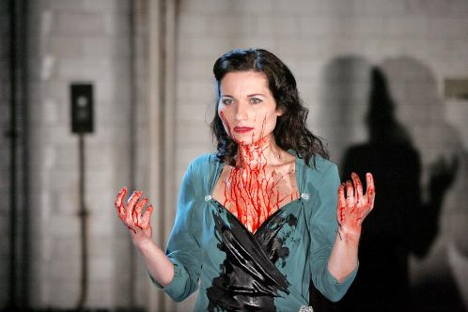
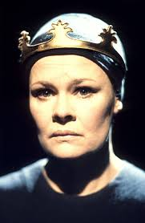
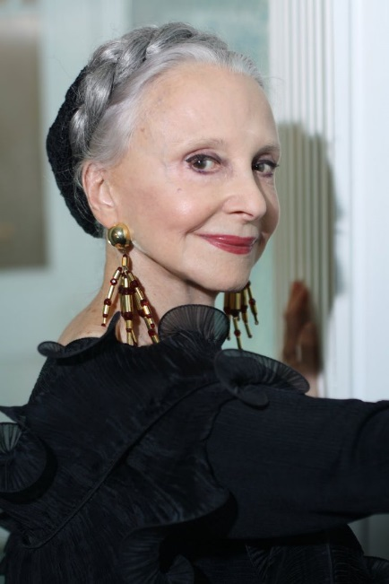
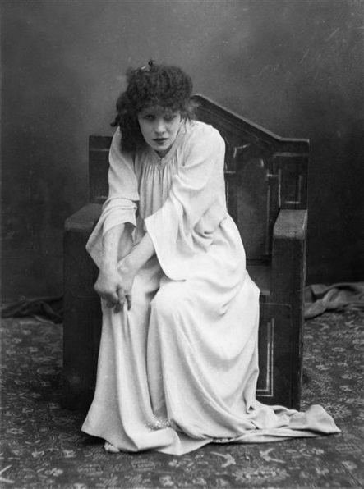
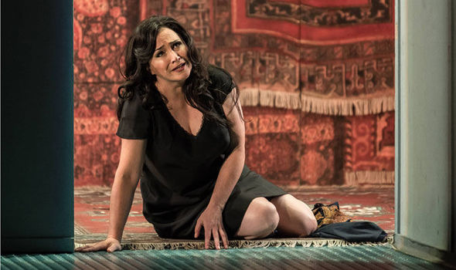
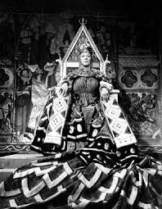
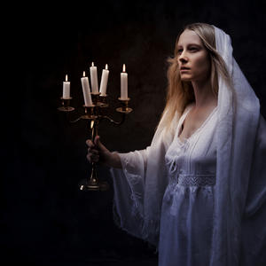
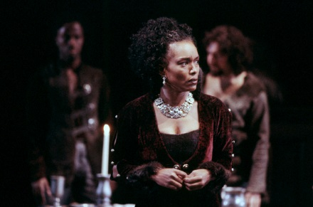
Which of these is the most accurate portrayal of Lady Macbeth?
Which of these is the odd one out?
Be prepared to explain your choices.

Slide 3
Each of these images represents the way a director has imagined Lady Macbeth. Shakespeare created her, and we MUST remember to write about her as if she’s made up for us to analyse.

Slide 4
To be able to write about characters as plot devices, and analyse the author’s manipulation of the reader.

Slide 5
Which of these qualities does Lady Macbeth possess in the play?
Cruelty
Ambition
Madness
Courage
Heroism
Evil
Sadness
Grief
Innocence
Stupidity
Power
Guile
Secrecy
Lies
Wickedness
Happiness
Fulfilment
What message do you think Shakespeare wanted to give the audience about women like Lady Macbeth?
Complete this sentence:
If you act like Lady Macbeth you will…
*try to use some of the words to the left in your sentence.

Slide 6
One of the ways we can gain marks on A02 is to write about characters, and how the author has constructed them to create an idea.

Slide 7
One of the ways we can gain marks on A02 is to write about characters, and how the author has constructed them to create an idea.
Band 6
Band 1

Slide 8
What’s wrong with this answer – mark it against the A02 criteria.
You are in your GCSE Literature exam, and have been asked to analyse how Lady Macbeth is presented as a villain.
‘Come, you spirits that then on mortal thoughts, un-sex me here/ And fill me from the crown to the toe, top full of direst cruelty.’
Lady Macbeth is really evil. She should care more about her husband than her power. She wants to be more of a man than him ‘unsex me here’, and her use of the determiner ‘here’ shows how quickly she wants to become male. I realised that she actually wants to be the king and control her husband. She asks to be ‘full of the direst cruelty’ the superlative adjective shows just how far she is willing to go. The metaphor echoes what she says about Macbeth being ‘full of the milk of human kindness’ the nourishing motherly noun milk makes Macbeth seem weak and womanly to me.

Slide 9
Sentence starters to improve your analysis:
Shakespeare portrays the character….
Shakespeare constructs the character of X to appear….
Shakespeare seems to have devised her character to suggest the moral that….
The character X is used by Shakespeare to show….
When Shakespeare writes the line….
The TERMINOLOGY is intended to make the character seem….
The audience realises…..
Shakespeare manipulates the audience to realise….

Slide 10
Now compare to this version:
What mark would you give it for A02 and why?
You are in your GCSE Literature exam, and have been asked to analyse how Lady Macbeth is presented as a villain.
‘Come, you spirits that then on mortal thoughts, un-sex me here/ And fill me from the crown to the toe, top full of direst cruelty.’
Shakespeare portrays the character of Lady Macbeth as really evil. He constructs the character to care less about her husband than her power. When Shakespeare writes the line ‘unsex me here’, his use of the determiner ‘here’ shows how quickly she wants to become male. Shakespeare manipulates the audience to realise that she actually wants to be the king and control her husband. When she asks to be ‘full of the direst cruelty’ the superlative adjective is used to show just how far she is willing to go. Shakespeare’s metaphor echoes what she says about Macbeth being ‘full of the milk of human kindness’ the nourishing motherly noun milk makes Macbeth seem weak and womanly to the audience.

Slide 11
GREEN PEN your answer from earlier adding 4 of these sentence starters.
Shakespeare portrays the character….
Shakespeare constructs the character of X to appear….
Shakespeare seems to have devised her character to suggest the moral that….
The character X is used by Shakespeare to show….
When Shakespeare writes the line….
The TERMINOLOGY is intended to make the character seem….
The audience realises…..
Shakespeare manipulates the audience to realise….

Slide 12
Top Tips from the Mock Examiner:
Use the word ‘character’ before the character’s name e.g. the character Macbeth.
Using the word character will get you above Band 1 on A02.
Write about characters as constructed by the playwright.
Don’t write as if you think characters are real people. Remember they are constructs.
Writing about the characters as if they are real people will put your answer into Band 1.
Shakespeare, as a playwright, wanted us to have certain thoughts about the characters.
Shakespeare MANIPULATES our feelings through the use of techniques: sneaky Shakespeare.
Nothing is by accident: it is always intentional, show the examiner you know this.

Slide 13
Continue your answer using some of the sentence starters provided and writing about these quotes.
You are in your GCSE Literature exam, and have been asked to analyse how Lady Macbeth is presented as a villain.
Continue your answer writing about this quote:
‘A little water clears us of this deed.’
‘Here’s the smell of blood still; all the perfumes of Arabia will not sweeten this little hand’
What is villainous about her, and does she have any good qualities? Is she a classic or stereotypical villain? Point
How does Shakespeare show she is villainous in the play? Evidence/ Terminology
Why does he do this? What does the audience realise, what does he want us to realise about the context? Effect/ Relate to context.

